Slide 1
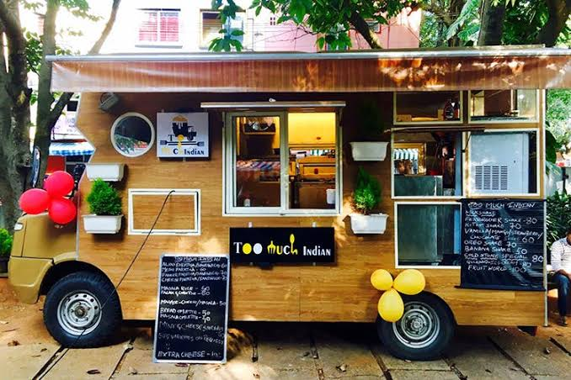
PROJECT ON ENTRPRENEURSHIP
DEVELOPMENT OF FOOD TRACK BUSINESS
GUIDED BY:-
projecteD BY:-
DR. APURBA GIRI (Assistant Professor and Head)
AYAN MONDAL (Assistant Professor)
Dept. of Nutrition
Mugberia Gangadhar Mahavidyalaya
PUSPA GIRI
Roll: 0452
B.Voc (Food Processing, 6th Sem)
Dept. of Nutrition
Mugberia Gangadhar Mahavidyalaya

Slide 3
CONTAINS
INTRODUCTION
CORE COMPANY
KEYS TO SUCCESS
LICENCE
PRODUCT AND SERVICES PRICE
RAW MATERIAL
LAYOUT
INVESTMENT
TERGATED CUSTOMER
HOW TO ATTRACET CUSTOMERS TO MY FOODE TRUCK?
MANPOWER AND PROFIT
MARKETING STRATEGIES
STP
CONTINUITY OR EXITING FROM BUSINESS
RISK

Slide 4
What is food truck business?
Introduction
A food truck is a mobile restaurant – a large truck, tailer, or van equipped to cook, prepare, serve and sell food. These food trucks enjoy the flexibility of moving to different locations and serving to different customers or clients if the market doesn’t suit them.
We lease a bike loader make a small kitchen body and starts our business.

Slide 5
Our Vision
Background Of The Plan
The main objective of the business plan is to find out how will our business work for new trend customers. To supply customers with healthy and freshly cooked food in a fast and efficient way.
I want to setup a Mobile Food Shop to provide hygienic and provide batter quality food to our customers at that place where people actually want from .

Slide 6
WHY I CHOOSE THIS TOPIC?
Food truck require low initial investment.
Food truck involves relatively low operation cost.
Food truck attract more customers.
Food trucks can experiment with location.
Food truck allow my to build a brand.
Food trucks have lower staffing cost.

Slide 7
Hygienic food
Organic ingredients
CORE
COMPANY
Easy to access
Competitive price
Innovative idea
Internet acess

Slide 8
Keys to success:
Create a unique, innovative, entertaining menu.
We want to be on the safe side of the business.
Sell the products that are of the highest quality.
Try to provide 100% satisfaction to our customers.
Encourage the two most important values.
Brand and image
Product good values of culture and business philosophy.

Slide 9
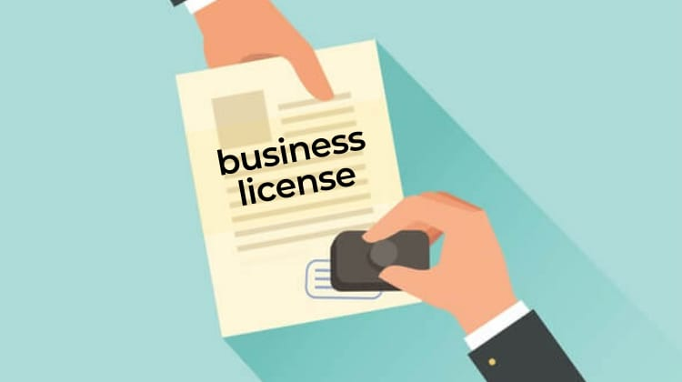
LICENCE:-
Fire safety certificate
Shop and Establishment Licence
NOC from RTO
NOC from municipal corporation
FASSI Mobile vendor’s licence
Kitchen insurance

Slide 10
Product and Service Price
PRODUCTP | PRICE
Tea, Coffee | 10,15-30₹
Fruits Juice(Lemon,Mango,Grapes,etc.) | 20-60₹
Sandwich | 15-45₹
Cheese Bread | 35-70₹
Lassi | 25-50₹
Falooda | 60-150₹
Diabetic Dahi | 10-30₹

Slide 11
RAW MATERIAL
Vegetables, fruits
Milk, Meat, Fish
Oil
Flour
Glass
Metal
Butter, cheese
Plastic
Straw

Slide 12
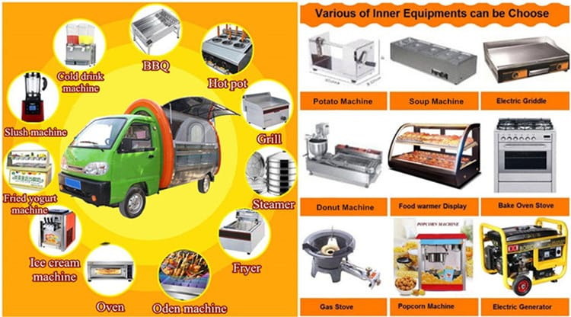
machinery
Microwave
Griddle
Refrigerator
Cutting board
Mixture
Knife
Frying pan
Commercial gas and oven
Hot pot
Slush machine

Slide 13
INVESTMENT:-
Total capital approx 5 lakhs 3 thousand
Small size food truck – 3 lakhs
Licence - 1 lakh
Truck colour and decoration - 50,000.00
Fire extinguisher - 1,549.00
Kitchen body - 30,700.00
Other Exp. – 20000.00
Total= 5,02,249₹

Slide 14
TARGETED CUSTOMER:-
Shopping areas.
Offices.
School.
Collage.
Parks.
Religious place.
Community centres.

Slide 15
HOW TO ATTRACT CUSTOMERS TO MY FOOD TRUCK?
Serve good food so I need to have a good product.
Show how my food is unique.
Differentiate myself from the competition.
Pick a good location.
Be creative with the design of my truck.
Install a TV screen.
Light up at night.

Slide 16
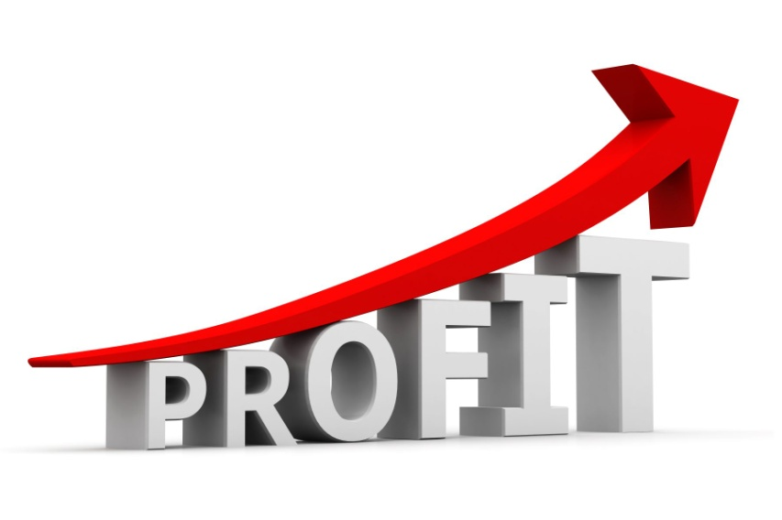
MANPOWER
I need 2 people
PROFIT
Depending on selling

Slide 17
Marketing Strategies
Selecting Business Scale
Relationship Marketing
Direct Marketing
Getting feedback
Cause Strategy
Market Expansion Strategy

Slide 18
Selecting Business Scale
I am new in this business so, I starts with 1 small size mobile food shop it not means that it will be like as a cart which you ever seen in markets but it is bigger than cart.
In starting I am doing work my sarrunding area.

Slide 19
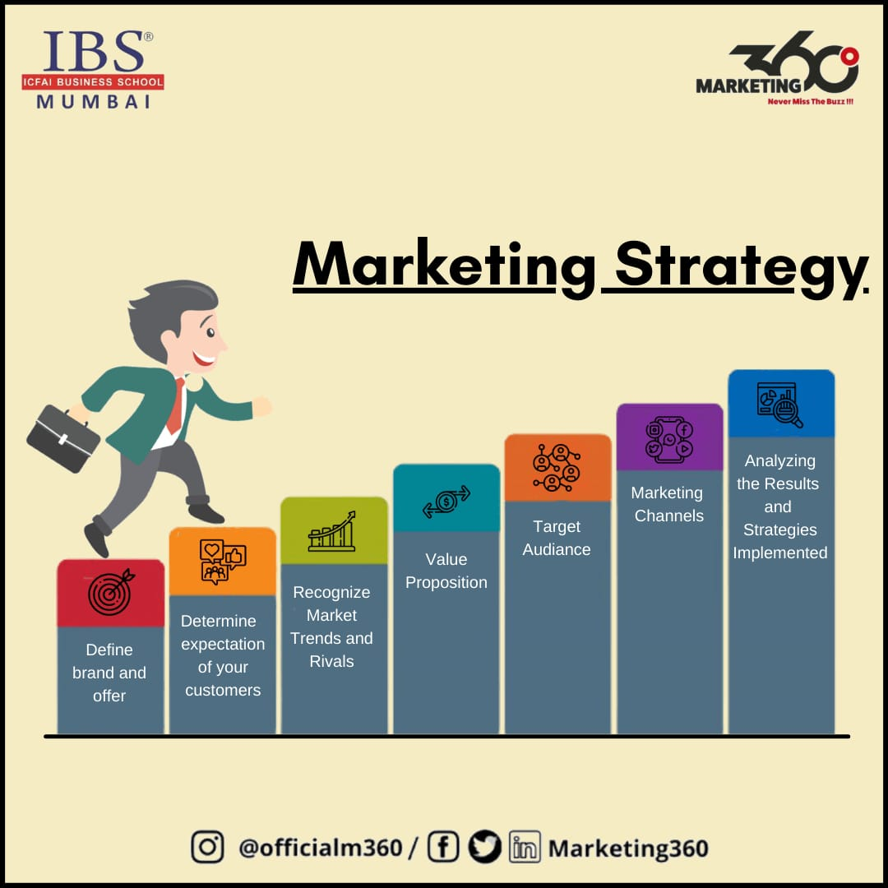
Relationship Marketing
It is an old and very effective strategy used in many businesses.
In this strategy I am focus on the long-term customer relationships to enhance reputation.
We will try to create strong, even emotional, customer connections to a brand that can lead us to ongoing business.

Slide 20
Direct Marketing
It is a form of advertising where we communicate directly to customers.
Through a variety of media including cell phone text messaging, email, websites, online advertisements, catalog distribution, and targeted television, newspaper advertisements.
One of the other important benefits of Direct Marketing is, it enables promoting products or services that might not have a strong brand.

Slide 21
Cause Strategy
If a business or brand doesn't stand for a cause, consumers may turn to your competitors.
We will provide Free WIFI to our customers while they are waiting for there menu to be served. Couse we want to Attract new customers by providing them internet access specially to youngers & youth.
We will try to make our customers happy by giving then some thing new, some thing extra.

Slide 22
Market Expansion Strategy
As with the passage of time we will extend our setup of Mobile food shop and we will also expand our market in other cities .
We will try our best to expand our business toward the Food Truck.
And Bring new innovations in our menu and in serving.
We will expand our market share by decreasing in price of product

Slide 23
Getting Feedback
I also get feedback from our customers through face to face because to get feedback from customers at the spot.
I will put a board where I will have food truck and put a chart good, poor, very good where after they eat they will say how the food I made went.
Getting suggestion from customers about our product make the use of social media.

Slide 24
Continuity or Exiting from Business
If our food shop business fails:
STEP BACK
REGROUP
ATTACK THE PROBLEM FROM DIFFERENT ANGLE
Because fail vendor are more likely to succeed in there next attempt.

Slide 25
Risk
▸ As it is a very simple business and is also very difficult to attract the customer but business is a going concern and you have to take risk if you want to see your idea in to a reality. I have to keep the prices low in start to attract the market.

Slide 26
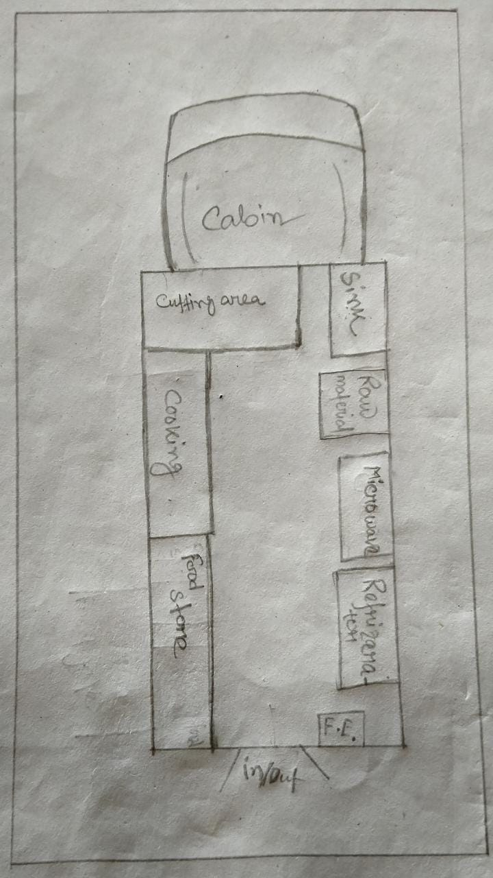

Slide 27
THANK YOU

